Slide 1
Common Defects

Slide 2
Common Defects - Introduction
Every software developer deals with defects. The really tough defects are the ones not detected by the compiler.
Nasty defects manifest themselves only when executed at runtime.
This topic is list of the top common defects:
Hard code constants
Errors with string
NullPointerException
Create objects in Loop
Code redundant
Memory waste
Code confused
Errors by using try/catch
6/8/2020
09e-BM/DT/FSOFT - ©FPT SOFTWARE – Fresher Academy - Internal Use
2

Slide 3
Common Defect 01 Hard code constants
Issue : with giving a fixed value in codes, for example:
dgrView.PageSize = 10
strErr = "Error message here";
The problem occurs when you should change these values multiple times!
Preventive: define constants in the common constant module or in a configure files
6/8/2020
09e-BM/DT/FSOFT - ©FPT SOFTWARE – Fresher Academy - Internal Use
3

Slide 4
Common Defects 02 Errors with string
Issue: Use string concatenated in loop:
String stNumber = "";
for(i=0; i<100; i++){
stNumber = stNumber + i;
}
Cause: Don’t understand String characteristic in Java.
Preventive: Use StringBuffer instead
6/8/2020
09e-BM/DT/FSOFT - ©FPT SOFTWARE – Fresher Academy - Internal Use
4

Slide 5
Common Defects 03 NullPointerException 01
Issue: FindBug examines the code for the statement that will surely cause the NullPointerException.
String stAction = request.getAttribute("stAction").toString();
Code execution will cause the NullPointerException
Cause: the developer does not check null or think about null object before accessing object's value.
Preventive: Should check null before accessing object or pointer before using its member
String stAction = request.getAttribute("stAction") == null ? "" : request.getAttribute("stAction")
6/8/2020
09e-BM/DT/FSOFT - ©FPT SOFTWARE – Fresher Academy - Internal Use
5

Slide 6
Common Defects 04 NullPointerException 02
Issue : Using the wrong form of ‘equal’ in conditionals can result in a bug NullPointerException.
if(stVariable.equals(“”)) {//code execution will cause the NullPointerException
// do smt here
}
Preventive : Compare a string with a constant, always call equals function from constant to avoid null pointer exception error
// Correct answer:
if("".equals(stVariable) {
// do smt here
};
6/8/2020
09e-BM/DT/FSOFT - ©FPT SOFTWARE – Fresher Academy - Internal Use
6

Slide 7
Common Defects 05 Create objects in Loop
Issue with variables or create objects in Loop?
for (int i=0; i<dt.Rows.Count-1; i++){
String strName;
strName = dt.Rows[i]["Name"].ToString();
//do something here
}
Impact to the application performance!!!
Cause: memory is allocated repeatedly.
Preventive:
Variables should be declared before the loop statement or inside for() statement
Determine objects before loop statement
6/8/2020
09e-BM/DT/FSOFT - ©FPT SOFTWARE – Fresher Academy - Internal Use
7

Slide 8
Common Defects 06 Code redundant
Issues : Create new Object while we can reuse the object in previous command:
LearningPoint lrnPoint = new LearningPoint ();
lrnPoint = student.getLearningPoint();
Object are initiated but it is not used
Preventive: Declare Object = null instead of new object
LearningPoint lrnPoint = null;
lrnPoint = student.getLearningPoint();
6/8/2020
09e-BM/DT/FSOFT - ©FPT SOFTWARE – Fresher Academy - Internal Use
8

Slide 9
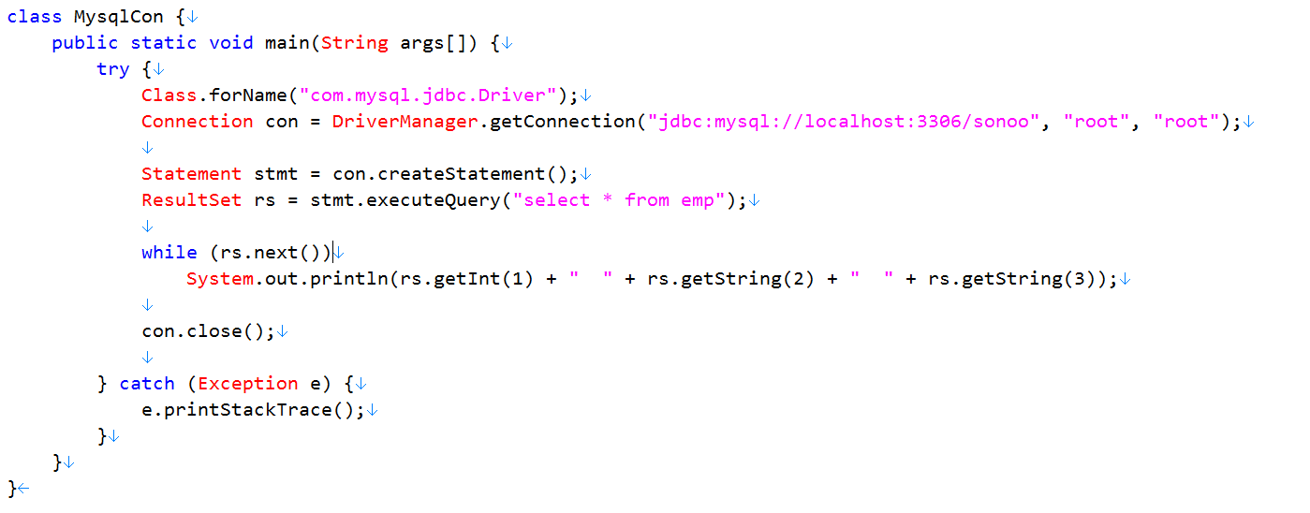
Common Defects 07 Memory waste 01
Issues : Database connections are not closed properly
Database object may not be close when an Exception occur !!
6/8/2020
09e-BM/DT/FSOFT - ©FPT SOFTWARE – Fresher Academy - Internal Use
9

Slide 10
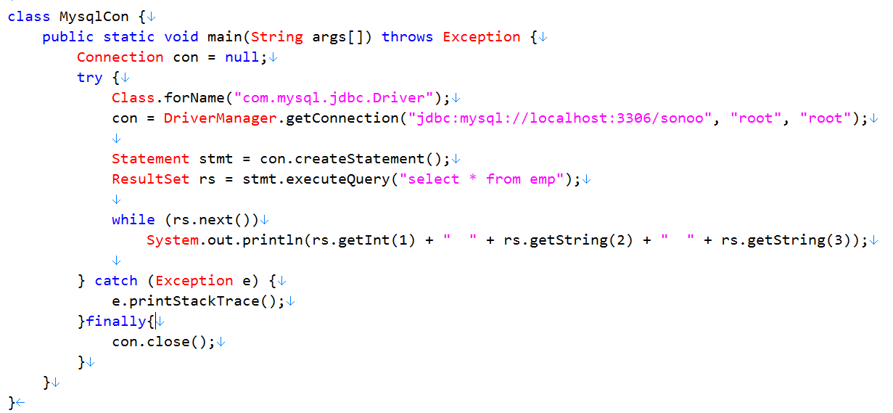
Common Defects 07 Memory waste 01 (Cont)
Preventive :
6/8/2020
09e-BM/DT/FSOFT - ©FPT SOFTWARE – Fresher Academy - Internal Use
10

Slide 11
Common Defects 08 Memory waste 02
Issue: Memory saving errors adversely affect system performance
Preventive:
File operations: file read operations must be restricted to a minimum
Clear content of big structure after use: always clear() the content of Collection/Map objects after use
Be economical when creating new objects
6/8/2020
09e-BM/DT/FSOFT - ©FPT SOFTWARE – Fresher Academy - Internal Use
11

Slide 12
Common Defects 09 Code confused
Preventive: use parenthese (), {}
if ((a == b) && (c == d)) {
….
}
if (condition) {
….;
}
Issue: Codes are confused
if (a == b && c == d) {
….
}
if (condition)
….;
6/8/2020
09e-BM/DT/FSOFT - ©FPT SOFTWARE – Fresher Academy - Internal Use
12

Slide 13
Common Defects 10 Errors by using Try/Catch
Issues: Errors by using Try/Catch
- Not delete System.out.print in block try/catch
- Use try/catch in statement for/while
- Use try/catch too much
Preventive :
- System.out.print must be deleted in block try/catch
- Not use in statement for/while
- use try/catch too much, should break to smaller functions
6/8/2020
09e-BM/DT/FSOFT - ©FPT SOFTWARE – Fresher Academy - Internal Use
13

Slide 14
Common Defects 10 Errors by using Try/Catch
Do not use try ... catch nested
// Wrong
Prefer:
try {
…
} catch () {
…
} catch() {
}
try {
try {
…
} catch() {
…
}
} catch () {
}
6/8/2020
09e-BM/DT/FSOFT - ©FPT SOFTWARE – Fresher Academy - Internal Use
14

Slide 15
THANK YOU!

